Slide 1
Digital-analog Variational Quantum Eigensolver

Slide 2
Problem
More Digital Gates More Noise

Slide 3
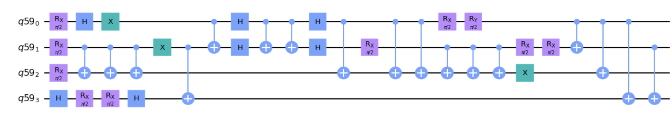
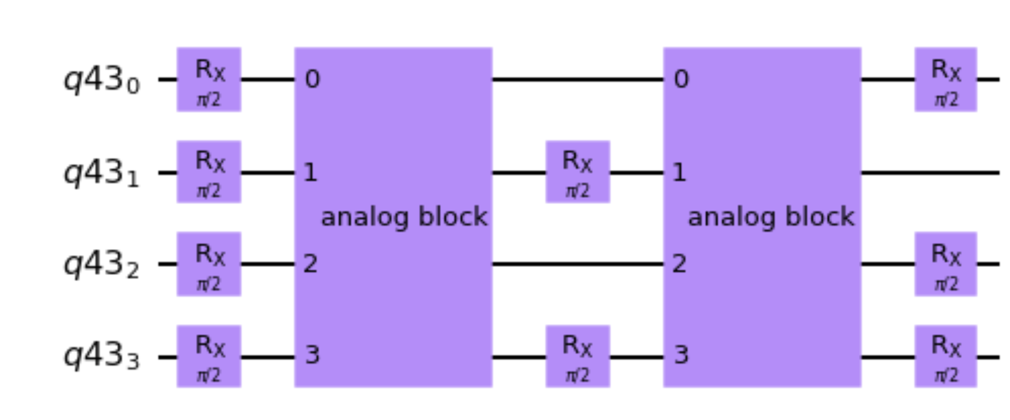
Digital Analog Block Approach = Digital Block + Analog Block
Less Gates Less Noise
[ Better value for Ground state Energy ]
By using analog block performing by zz Hamiltonian interaction as an entanglement resource
Reduce number of gates

Slide 4

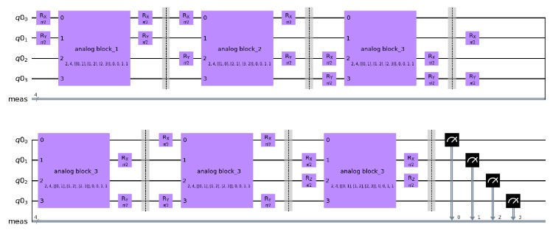
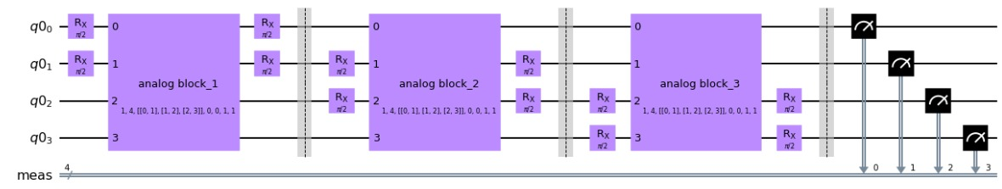
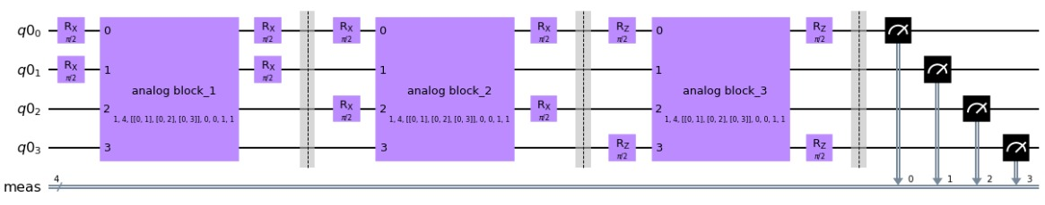
Our Solution - Implementation On H2 molecule – Using
All- Connectivity
Different Configurations
1- chain Dimensional
Star Configuration

Slide 5
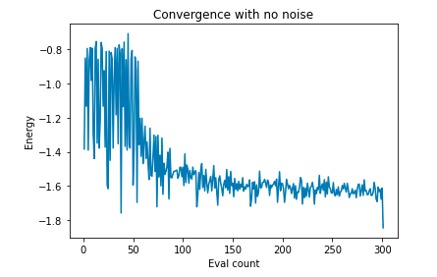
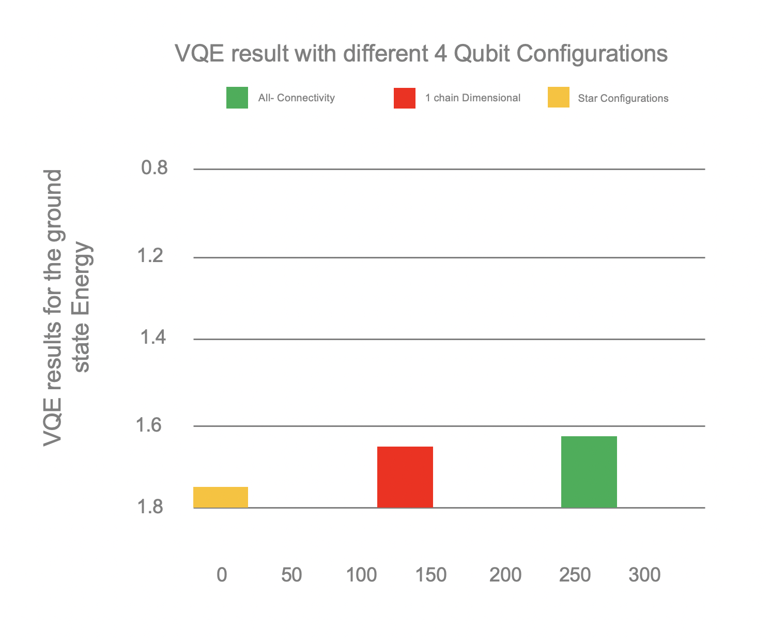
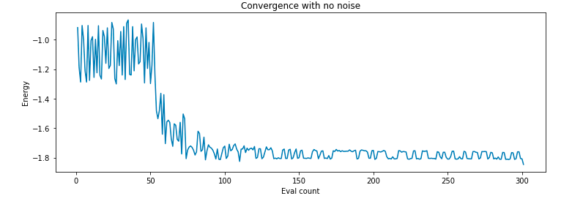
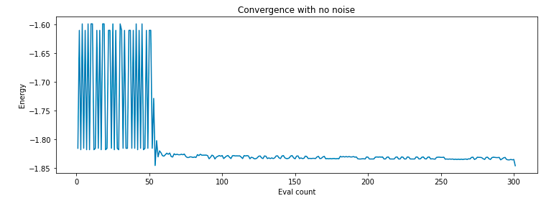
Our Solution - Implementation On H2 molecule – Using
All- Connectivity
1- Chain Dimensional
Results
Star Configuration
Less Connectivity = More convergence

Slide 6
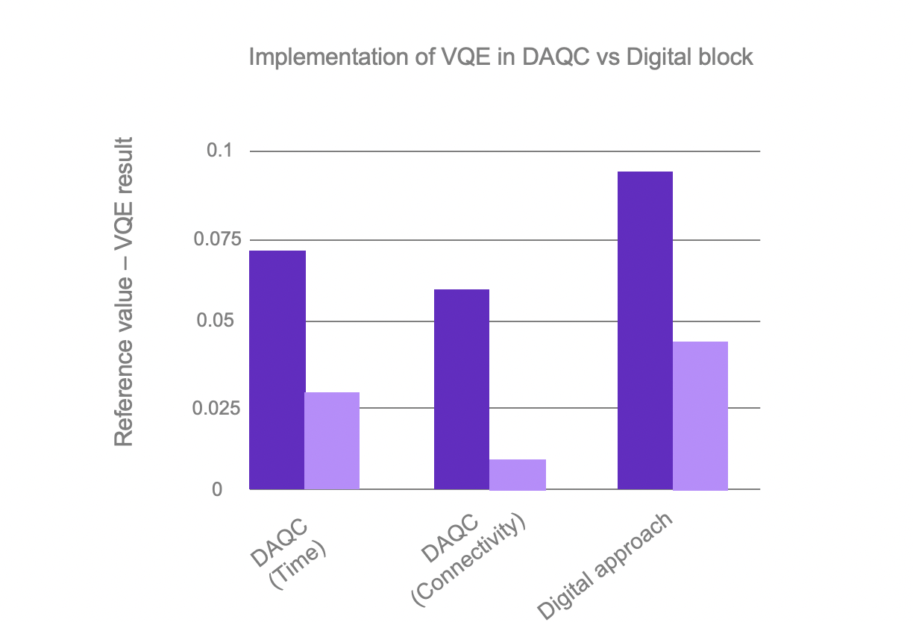
VQE in DAQC Vs Digital block
Played with Different parameter
Time
Qubits connectivity

Slide 7
Our team discover new problem
Inspired from the DAQC
Classical optimizers are not efficient for Digital Analog Approach as it the Digital approach
How to optimize to our ansatz for the new approach DAQC with a better optimizers than (ADAM, SPSA, etc)

Slide 8
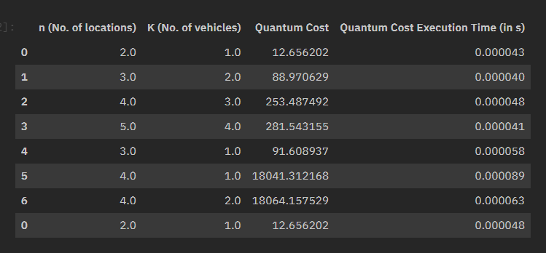
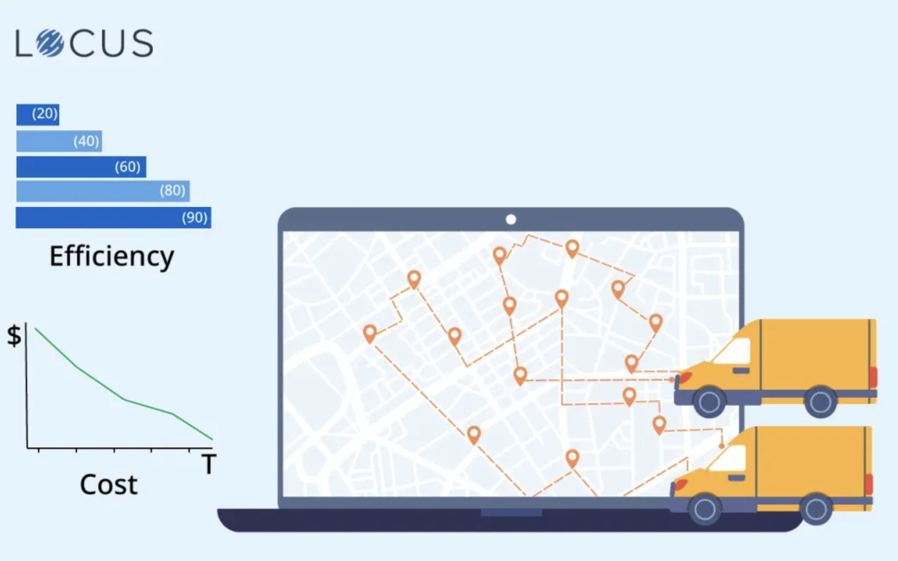
What is Done?
Logistics is a major industry, with some estimates valuing it at USD 8183 billion globally in 2015, the vehicle routing problem (VRP) is a combinatorial problem which asks “ What is the optimal set of routes for a fleet of vehicles to traverse in order to deliver to a given set of customers?”
Cost using VQE digital block
We are working
Cost using VQE digital Analog block

